Slide 1


Music Trend
Team 1
Aidan McMurry
Amos Fung
An Bui
Shadi Askarzadeh
Jan 23, 2020

Slide 2
Introduction
Why Music?
Universal
Major industry with Billions of revenues
Good pool of data
Our Study
Audio features for different countries utilizing the top 50 songs.
Generate comparison between features and countries.
Notes:
Aidan

Slide 3
Study Plan
Data Collection
Spotify API
Statistical Analysis Tools
Pearson correlation coefficient
Analytics results
Audio features comparison with the global data
Combine data
Audio features trend among countries
Two-way T test Analysis
Export to csv for analysis – 12 files
Mean and frequency comparison
Notes:
Amos

Slide 4
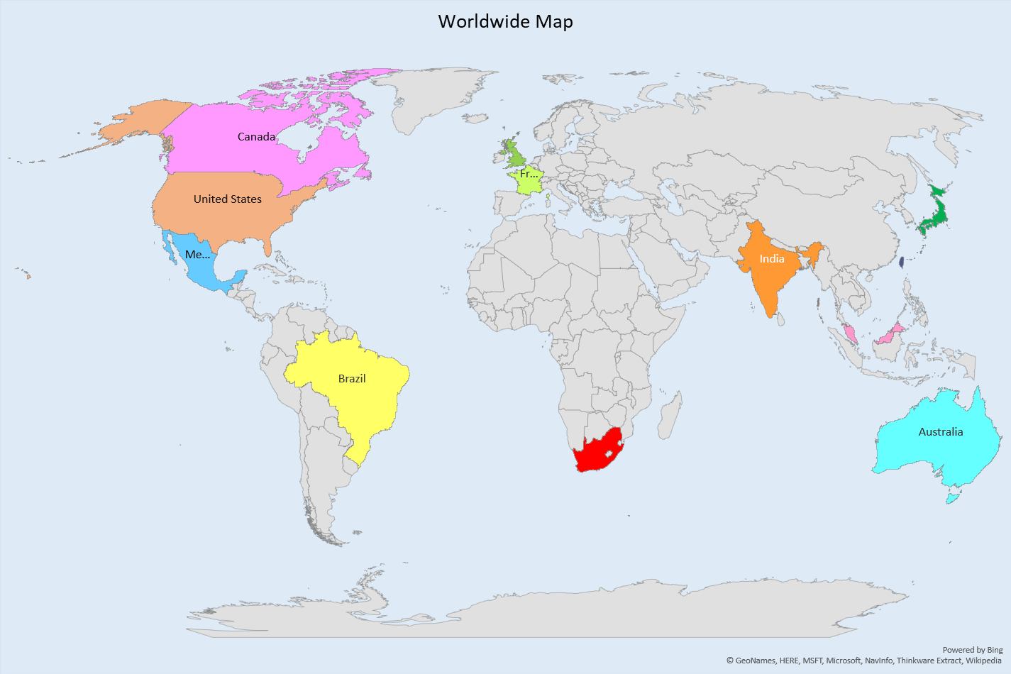
Data Selection
Countries: 11 countries
India, UK, USA, Brazil, Japan, Malaysia, Australia, France, South Africa, Taiwan, Hong Kong, Global
Audio Features
13 elements from Spotify
Loudness
Energy
Mode
Tempo
Key
Danceability
Speechiness
Acousticness
Instramentalness
Liveness
Valence
Duration
Time Signature
Notes:
An?

Slide 5
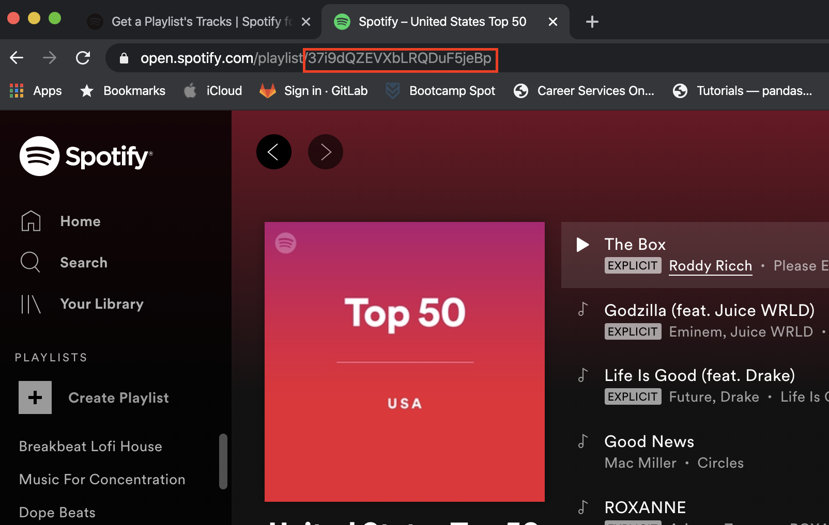
SPOTIFY API
Spotify conveniently maintains top 50 playlists by popularity for many regions
Uses Oauth 2.0 for authentication, handled by Spotipy package
All data pulled on Saturday, January 18th
Notes:
Amos

Slide 6
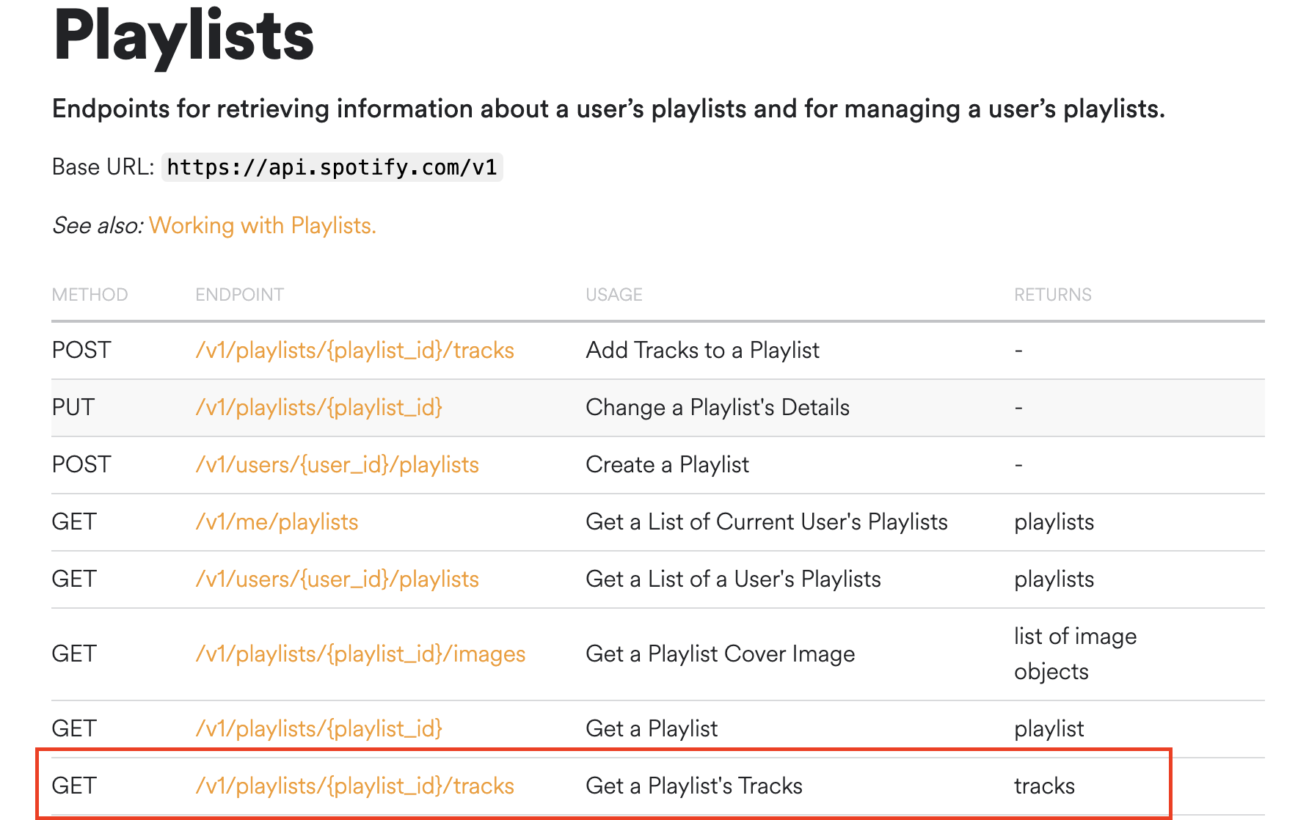
Notes:
Amos

Slide 7
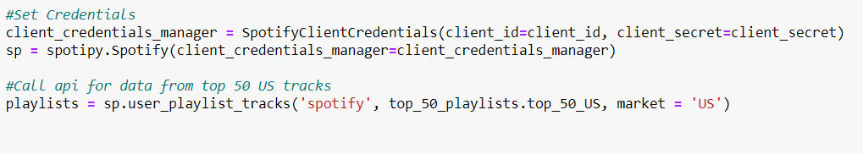
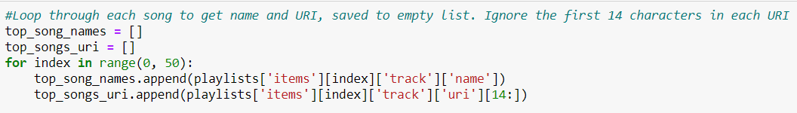
API CALLING
Notes:
Amos

Slide 8
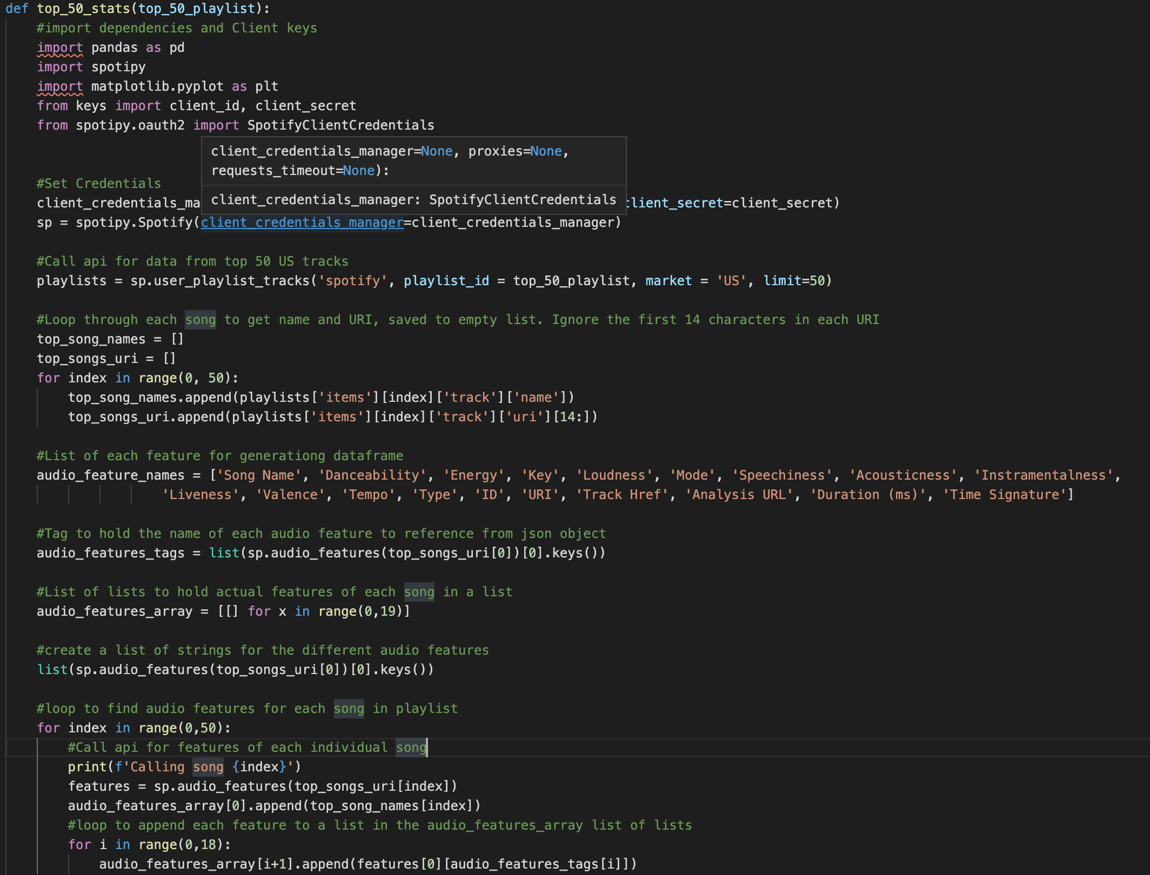
Notes:
Amos

Slide 9
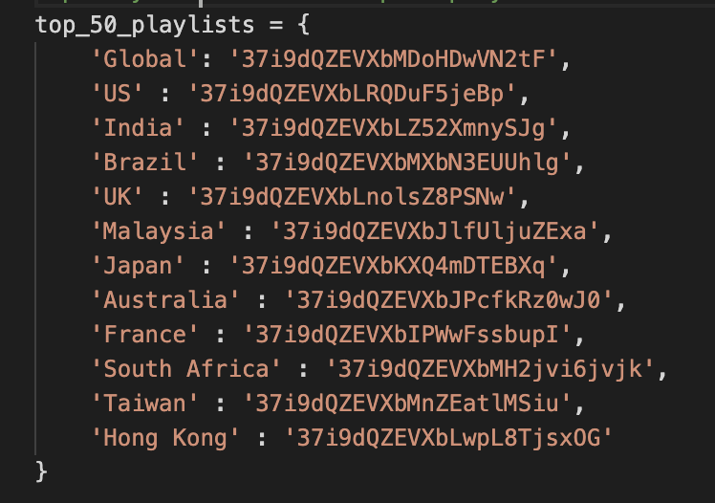
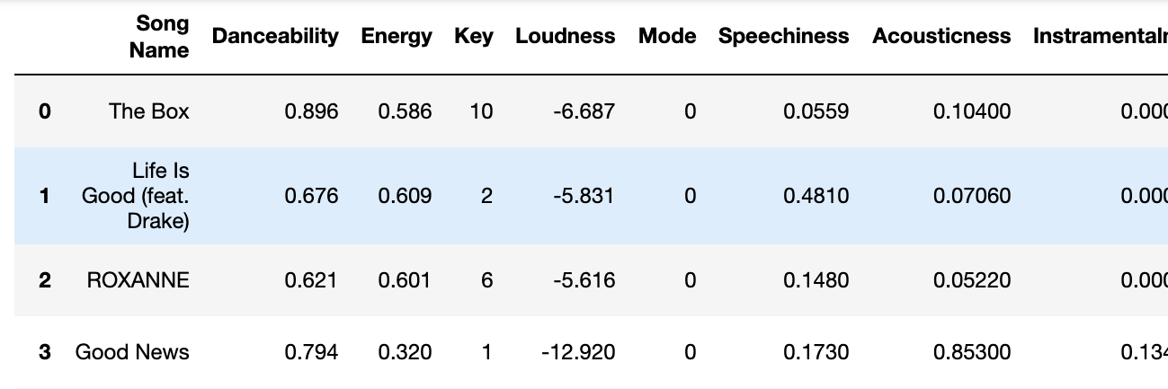
Loop through dictionary of Country: Spotify ID
Generate dataframe of audio features for top 50 songs in each country
Notes:
Amos

Slide 10
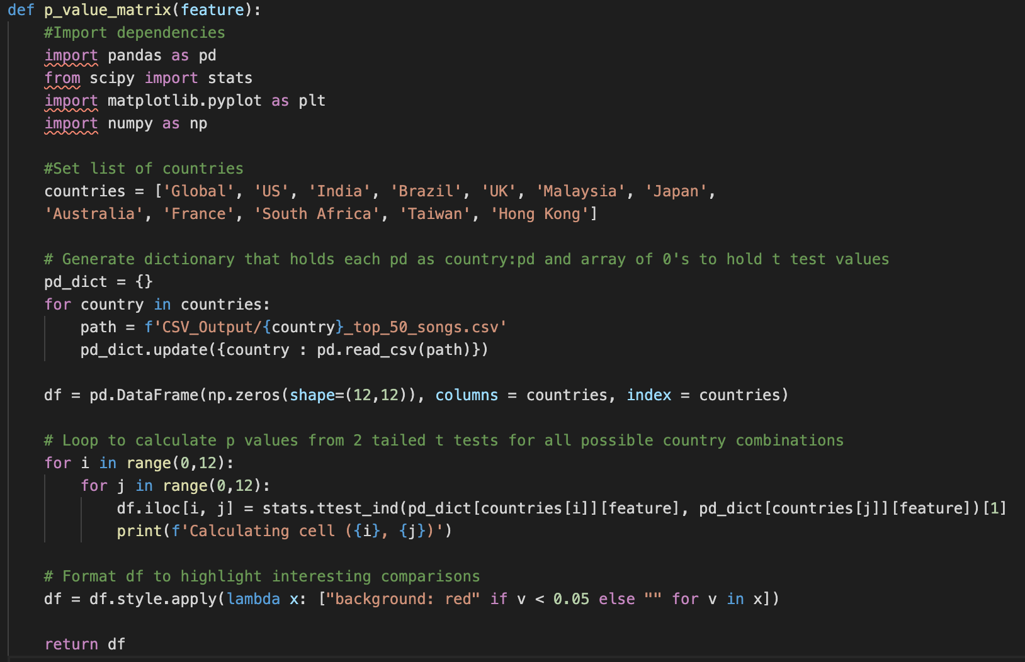
P-Value Calculation
Need to add codes and the results

Slide 11
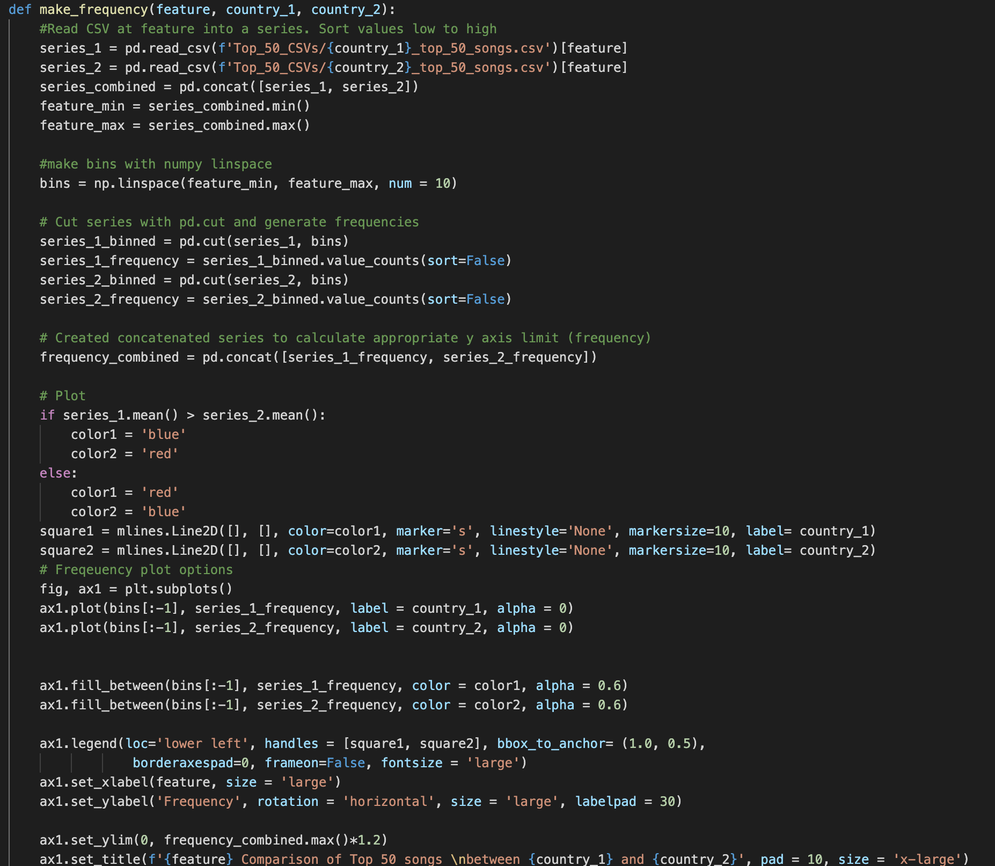

Slide 12
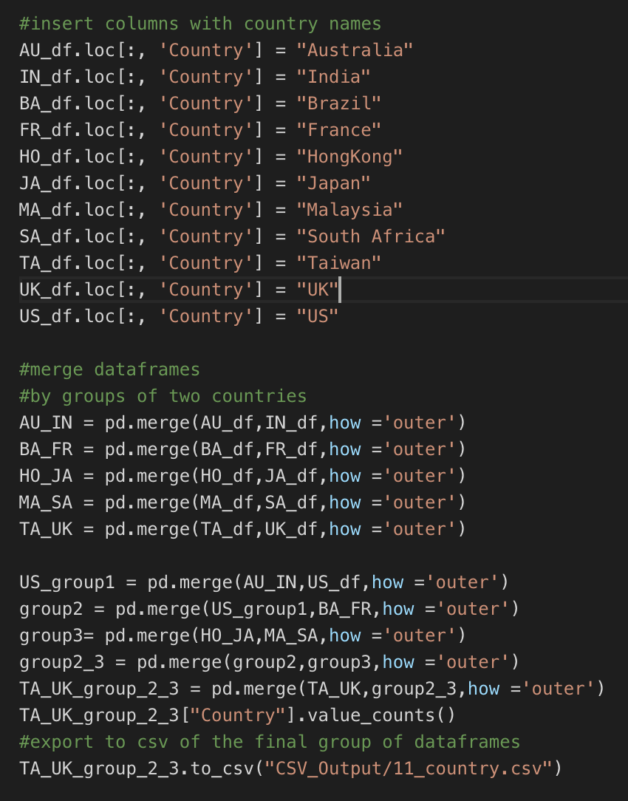
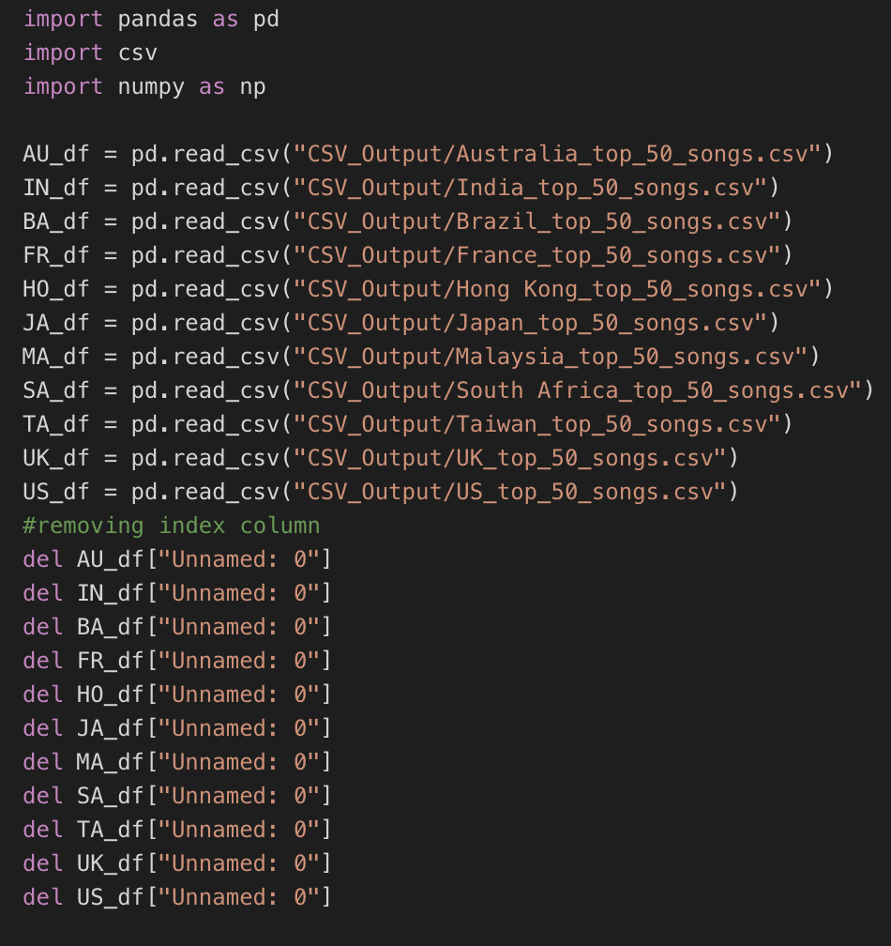
Combine to a master file
Notes:
Shadi

Slide 13
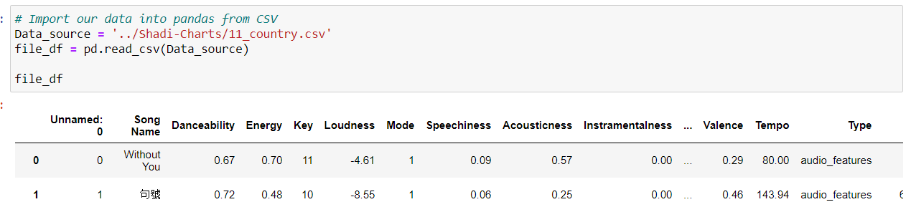
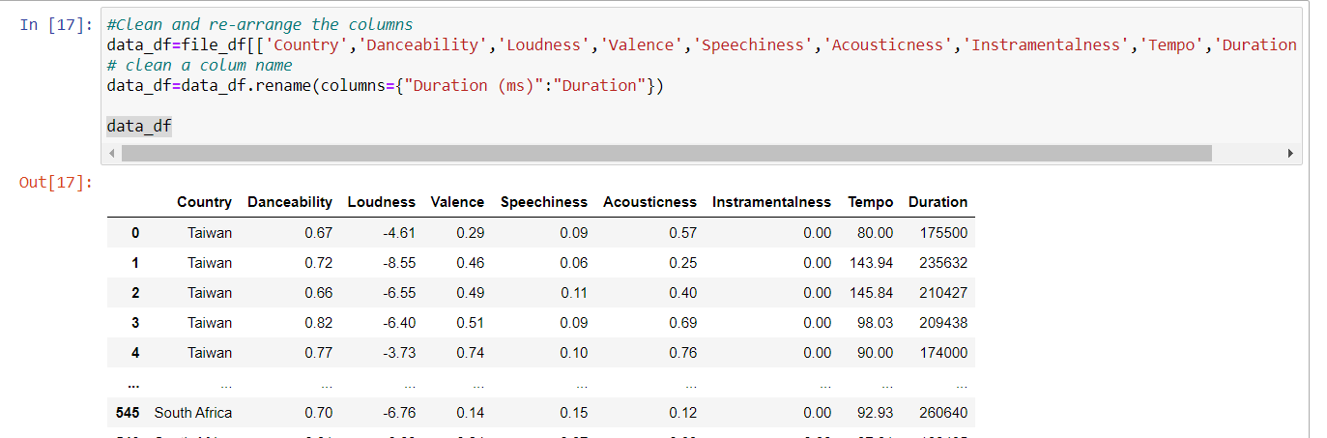
Code: Audio Features Correlation
Notes:
Shadi

Slide 14
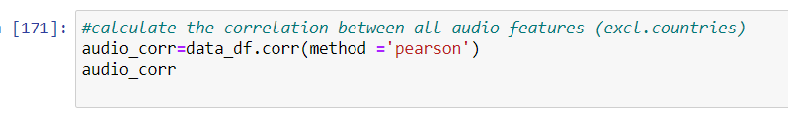
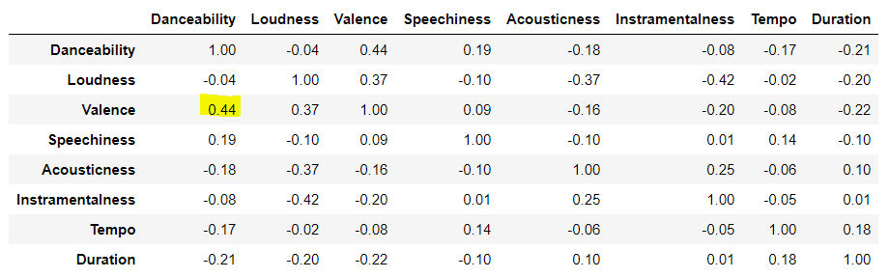
Audio Features Correlation Code
Notes:
Shadi

Slide 15
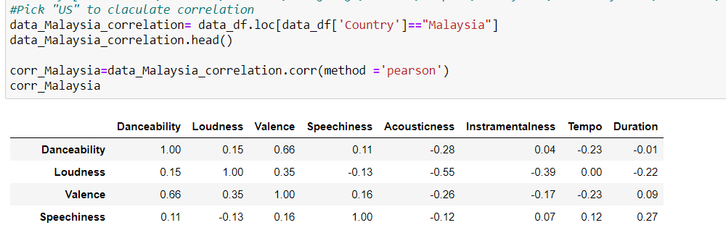
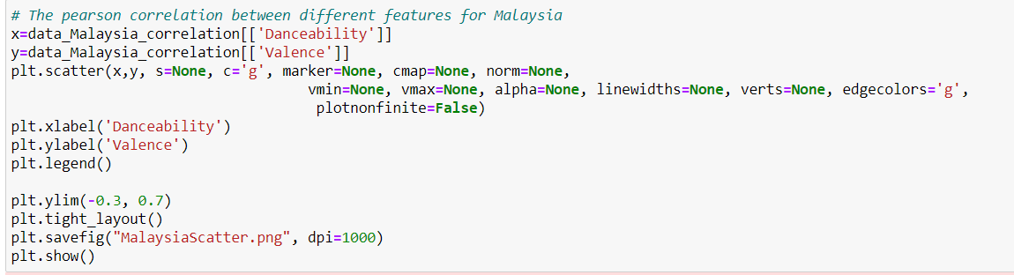
Code: Correlation at country level and scatter plot
Notes:
Shadi

Slide 16

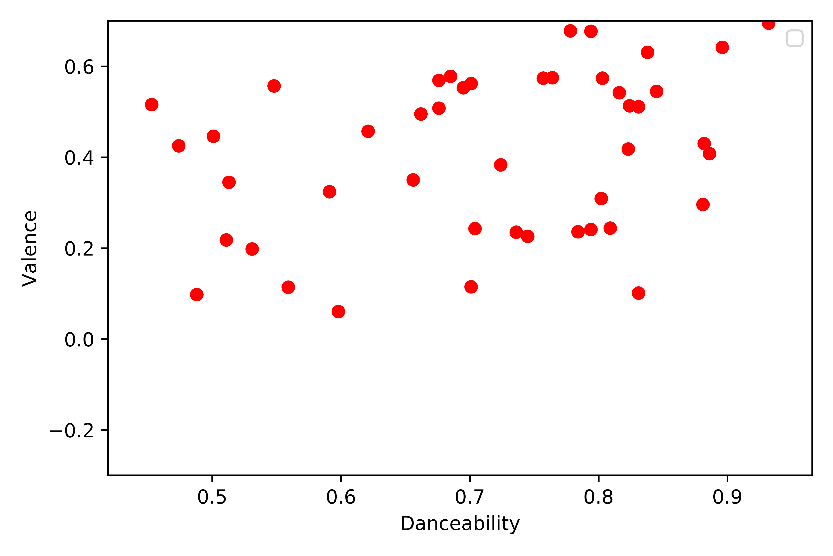

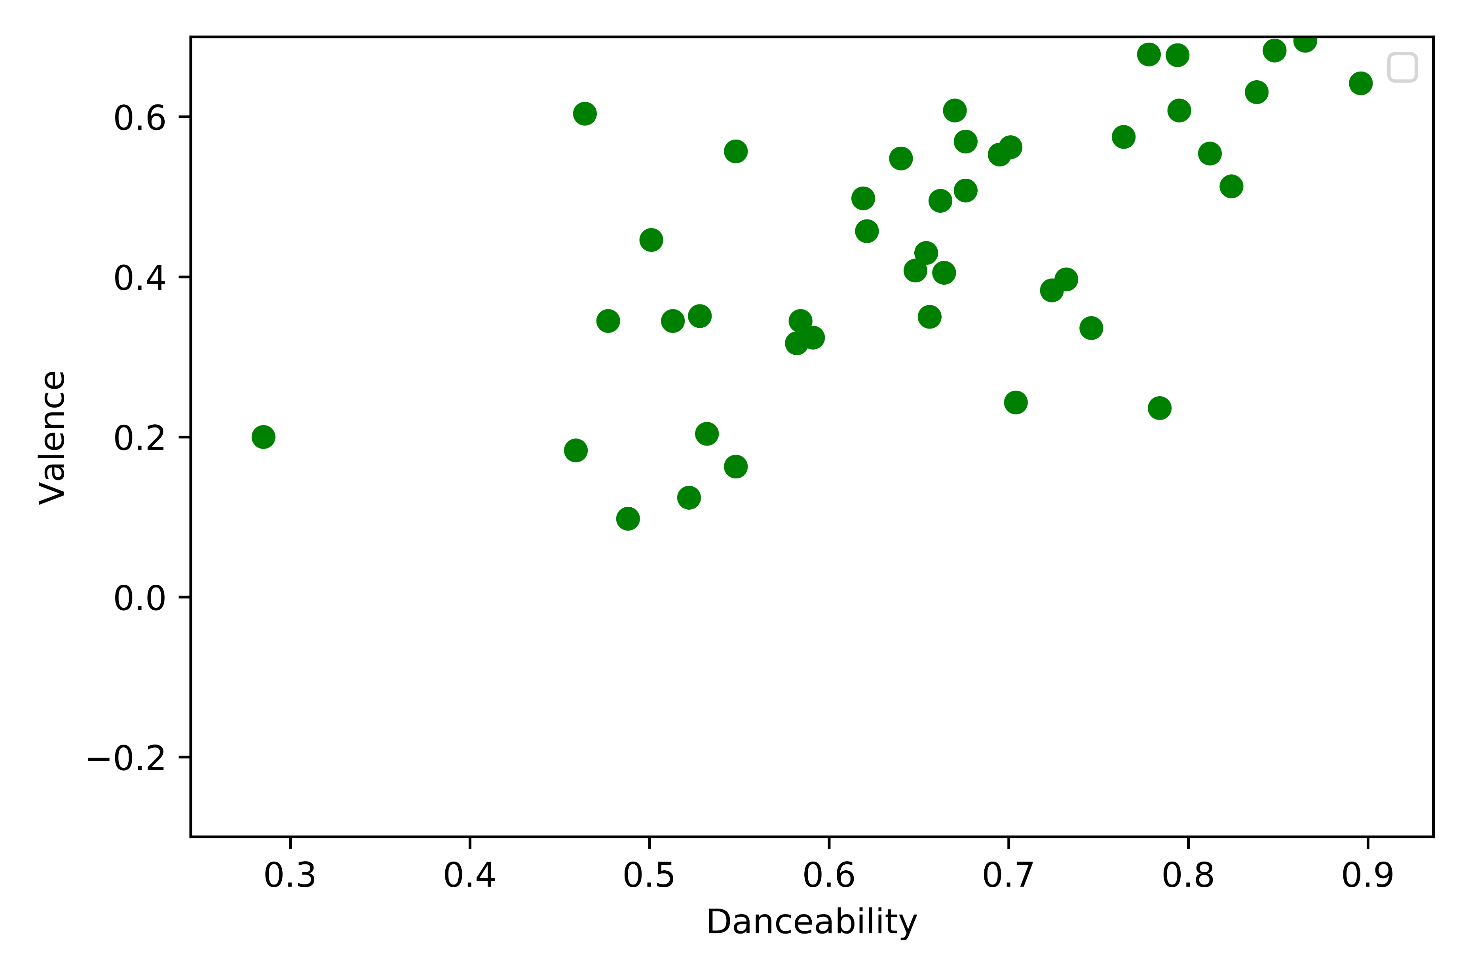
Danceability vs Valence
Countries | Pearson correlation
US | 0.35
Australia | 0.51
Brazil | 0.60
France | 0.36
Hong Kong | 0.55
India | 0.43
Japan | 0.63
Malaysia | 0.66
South Africa | 0.40
Taiwan | 0.57
UK | 0.46
Notes:
Shadi

Slide 17
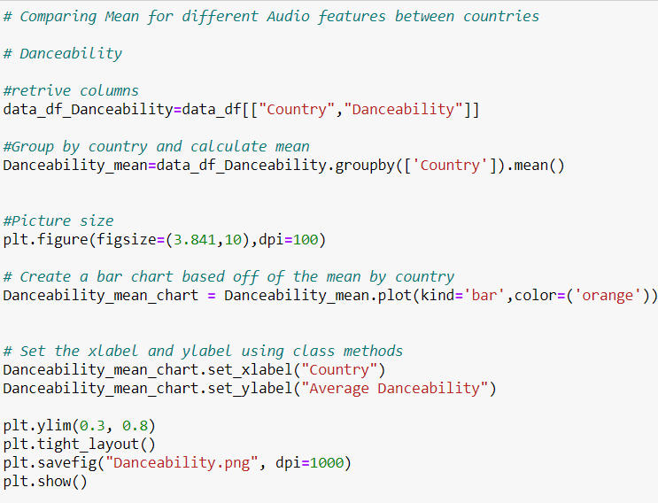

Codes: Bar & Frequency charts
Notes:
Shadi

Slide 18
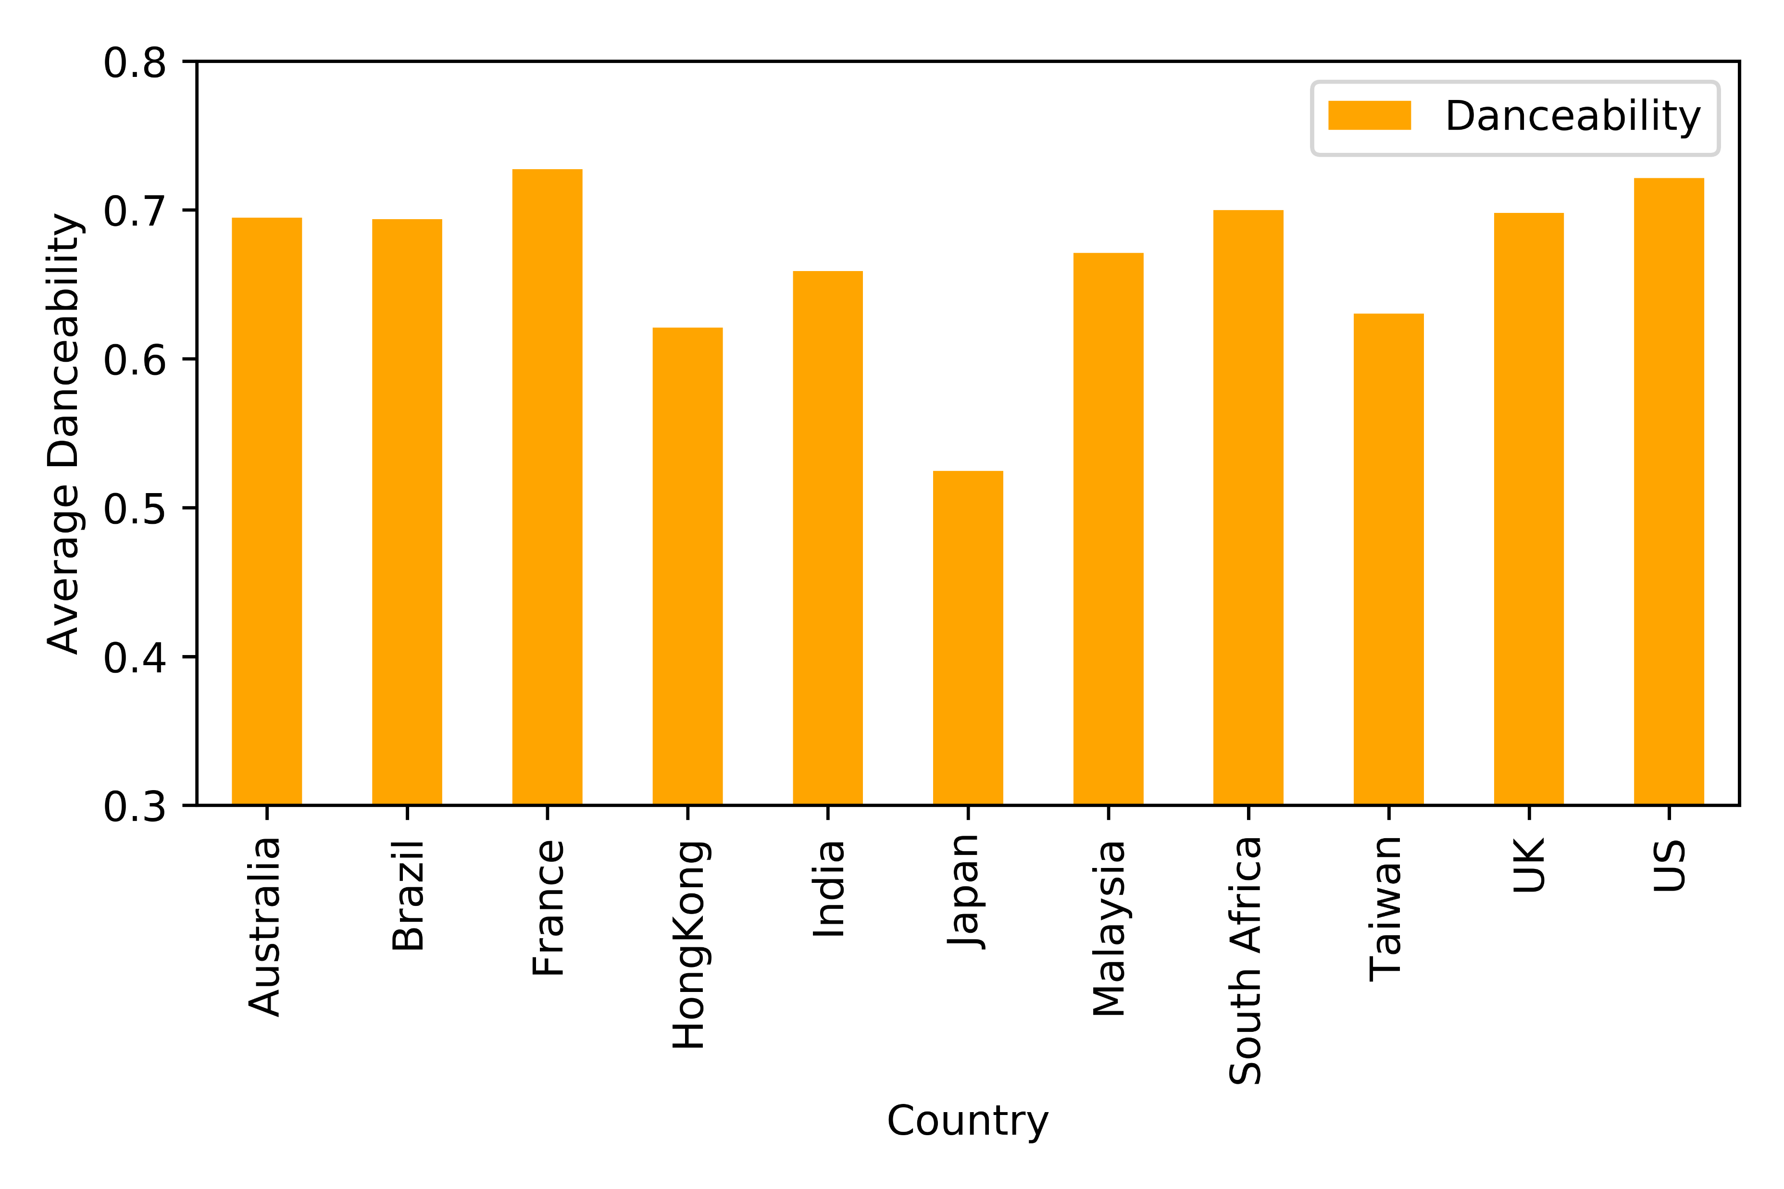
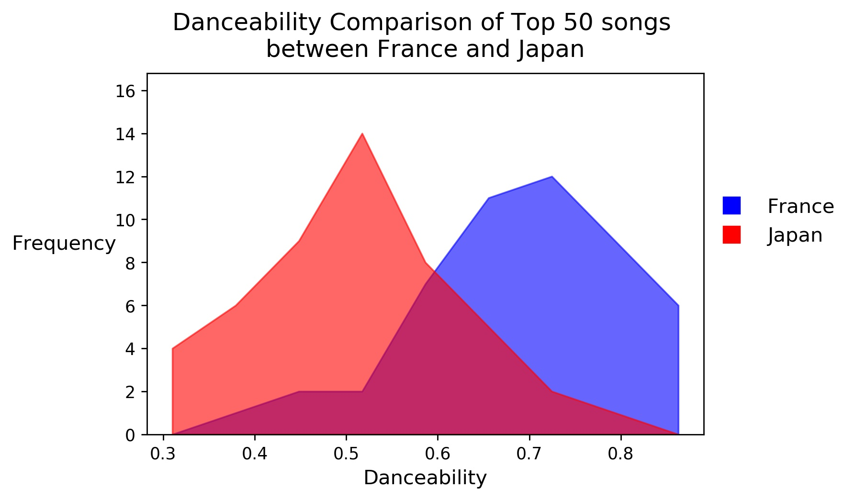
Danceability
How suitable a track is for dancing based on tempo, rhythm stability, beat strength, and overall regularity
Notes:
The frequency plot, the blue is the one with higher mean…population frequency between two countries with greatest danceability

Slide 19
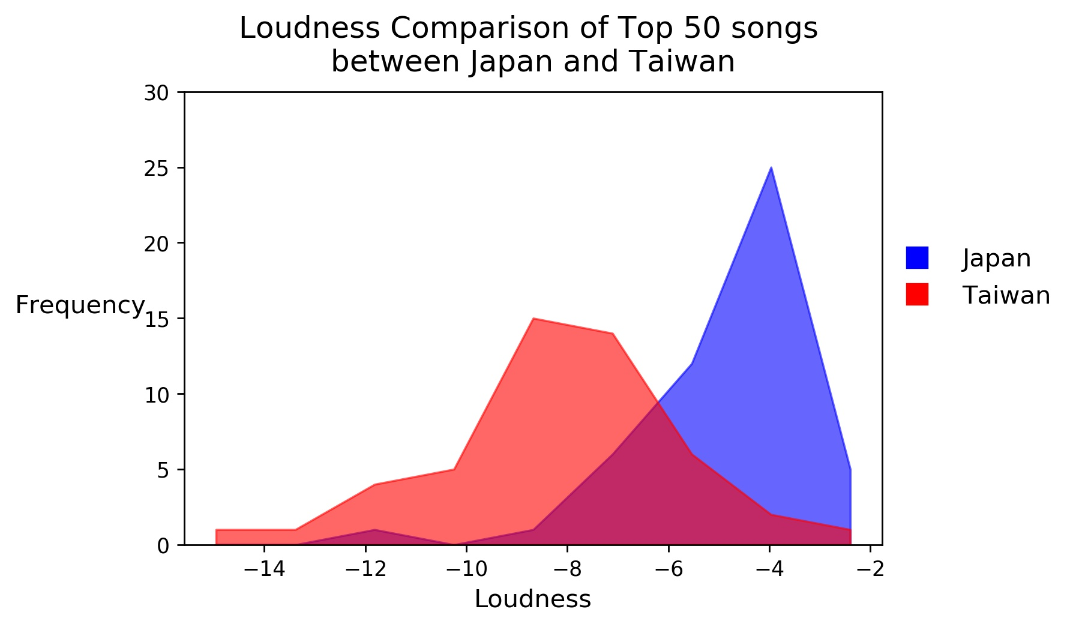
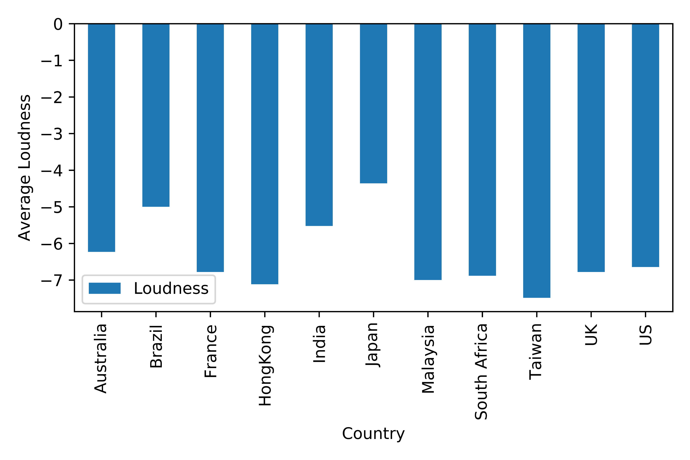
Loudness
The overall loudness of a track in decibels (dB).

Slide 20
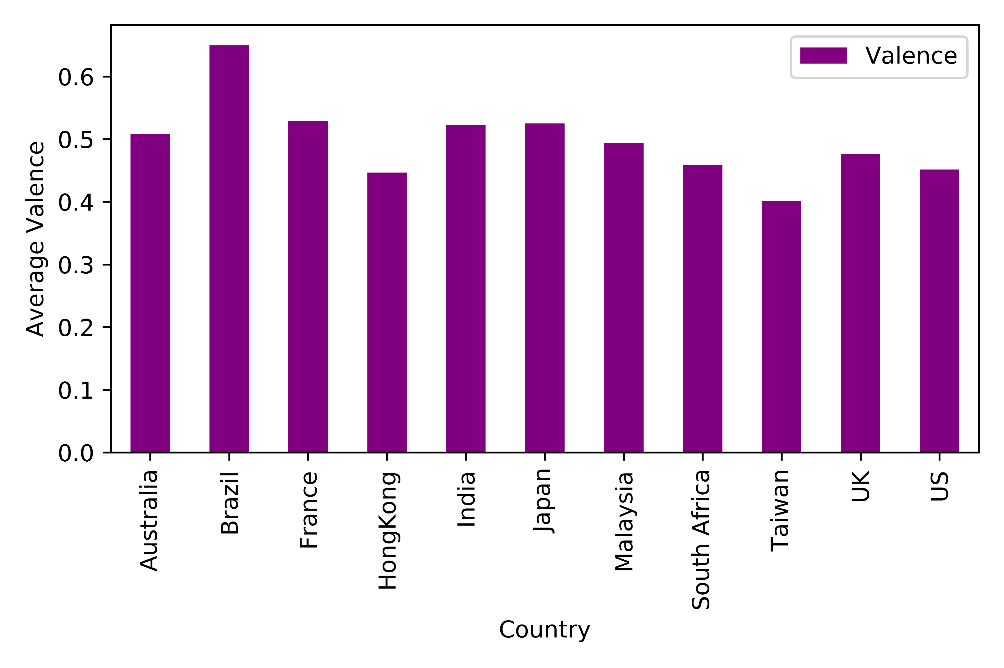
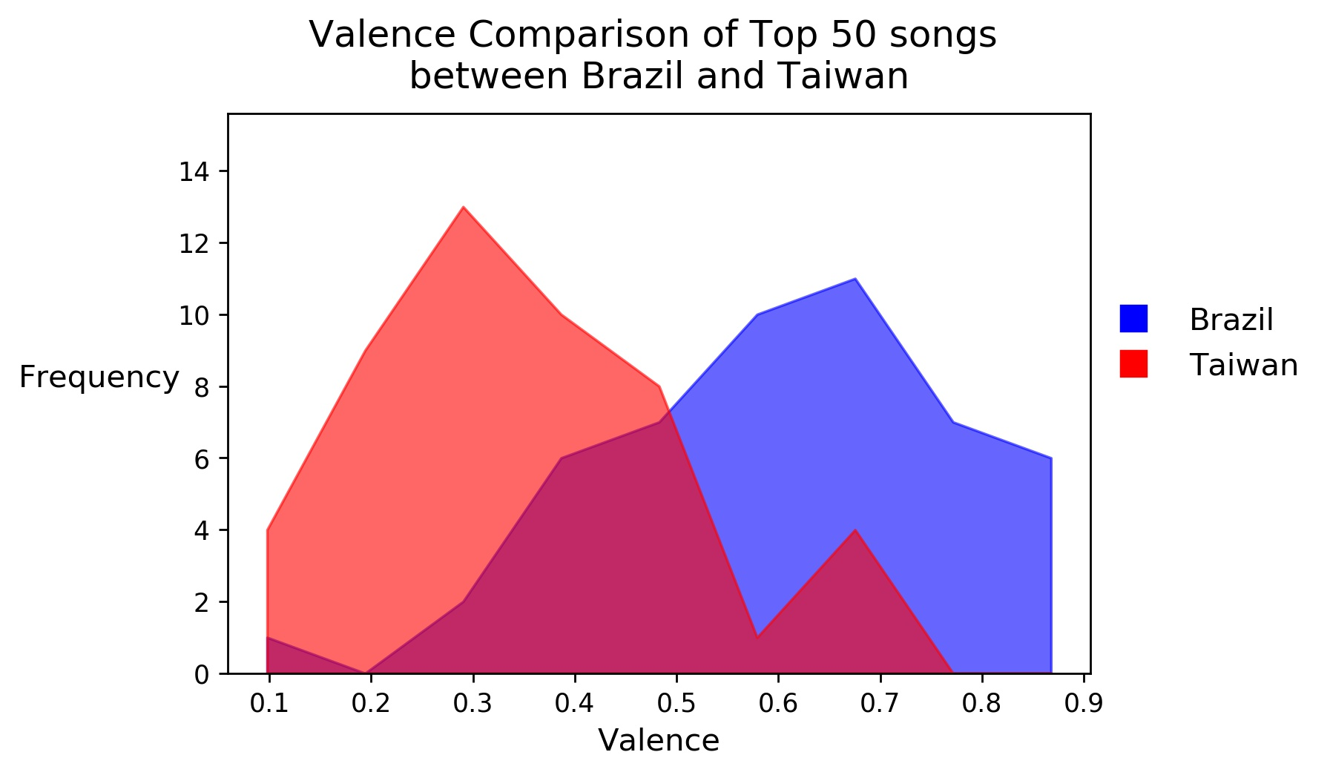
Valence
A measure from 0.0 to 1.0 describing the musical positiveness conveyed by a track

Slide 21
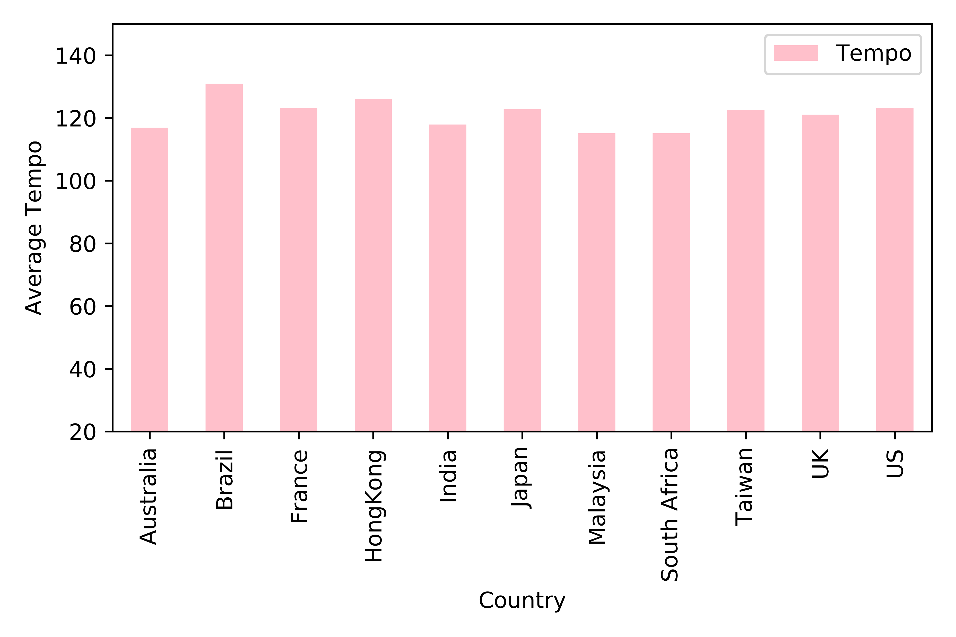
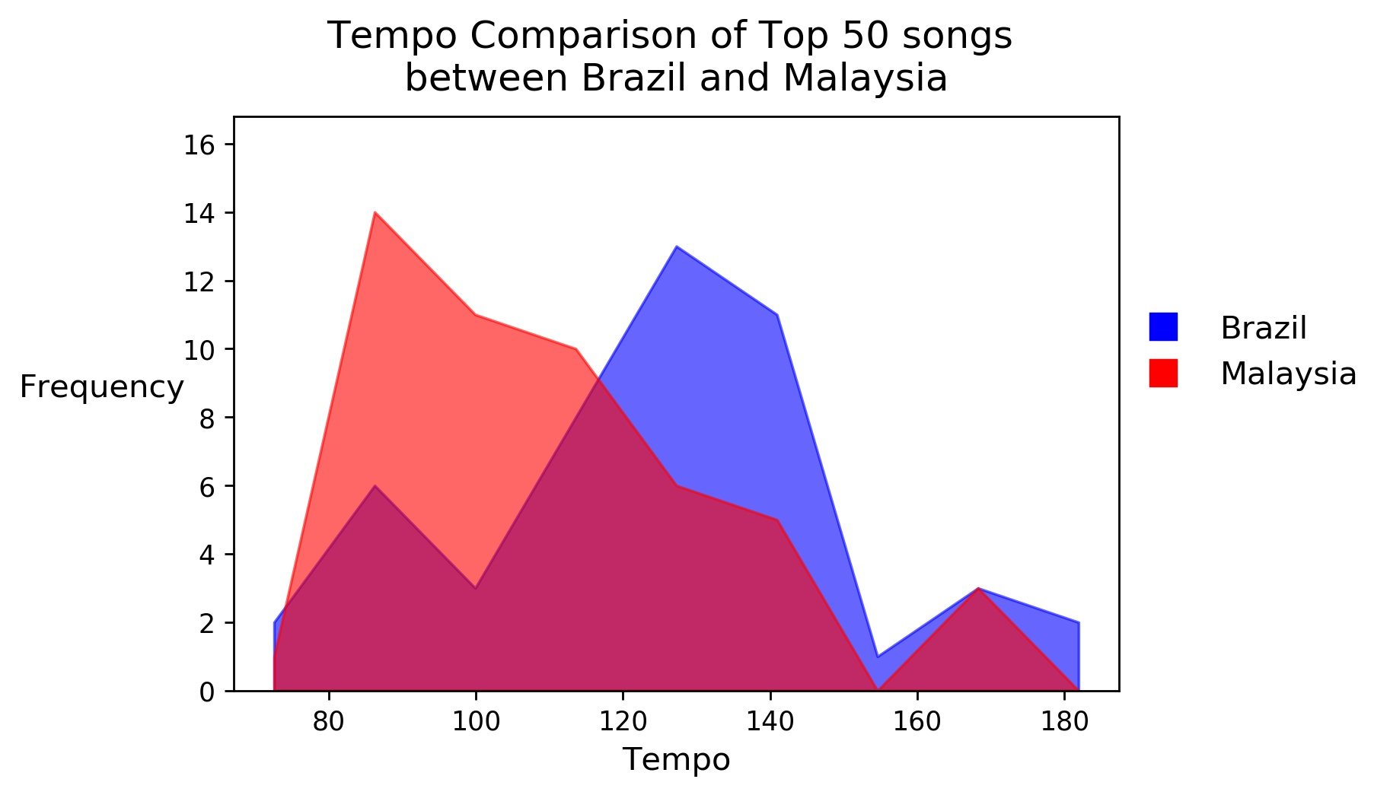
Tempo
Tempo is the speed or pace of a given piece and derives directly from the average beat duration.

Slide 22
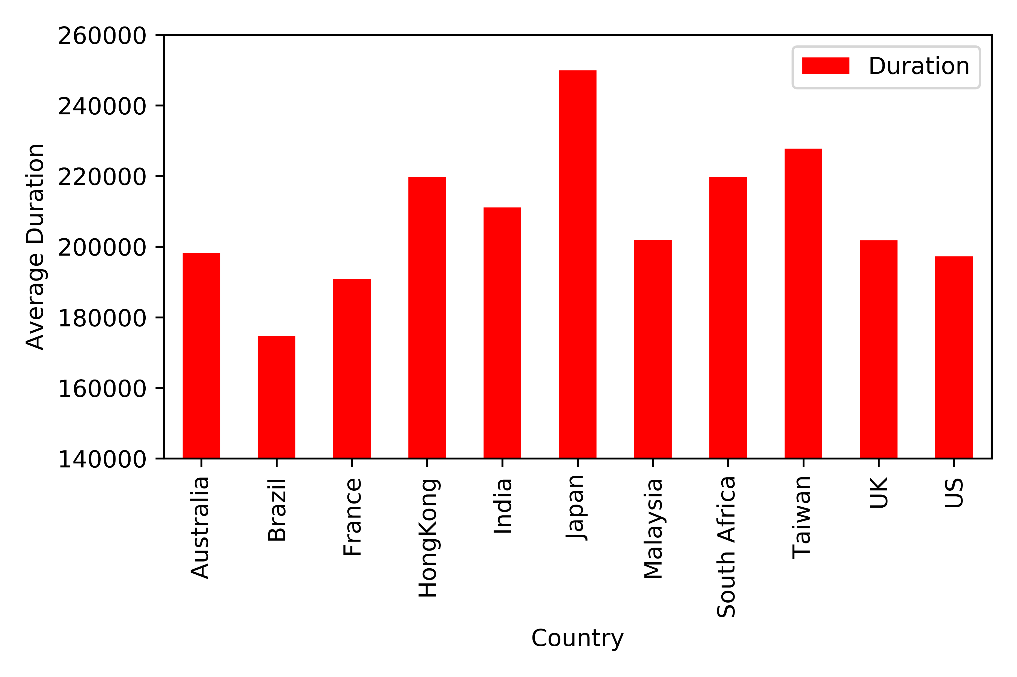
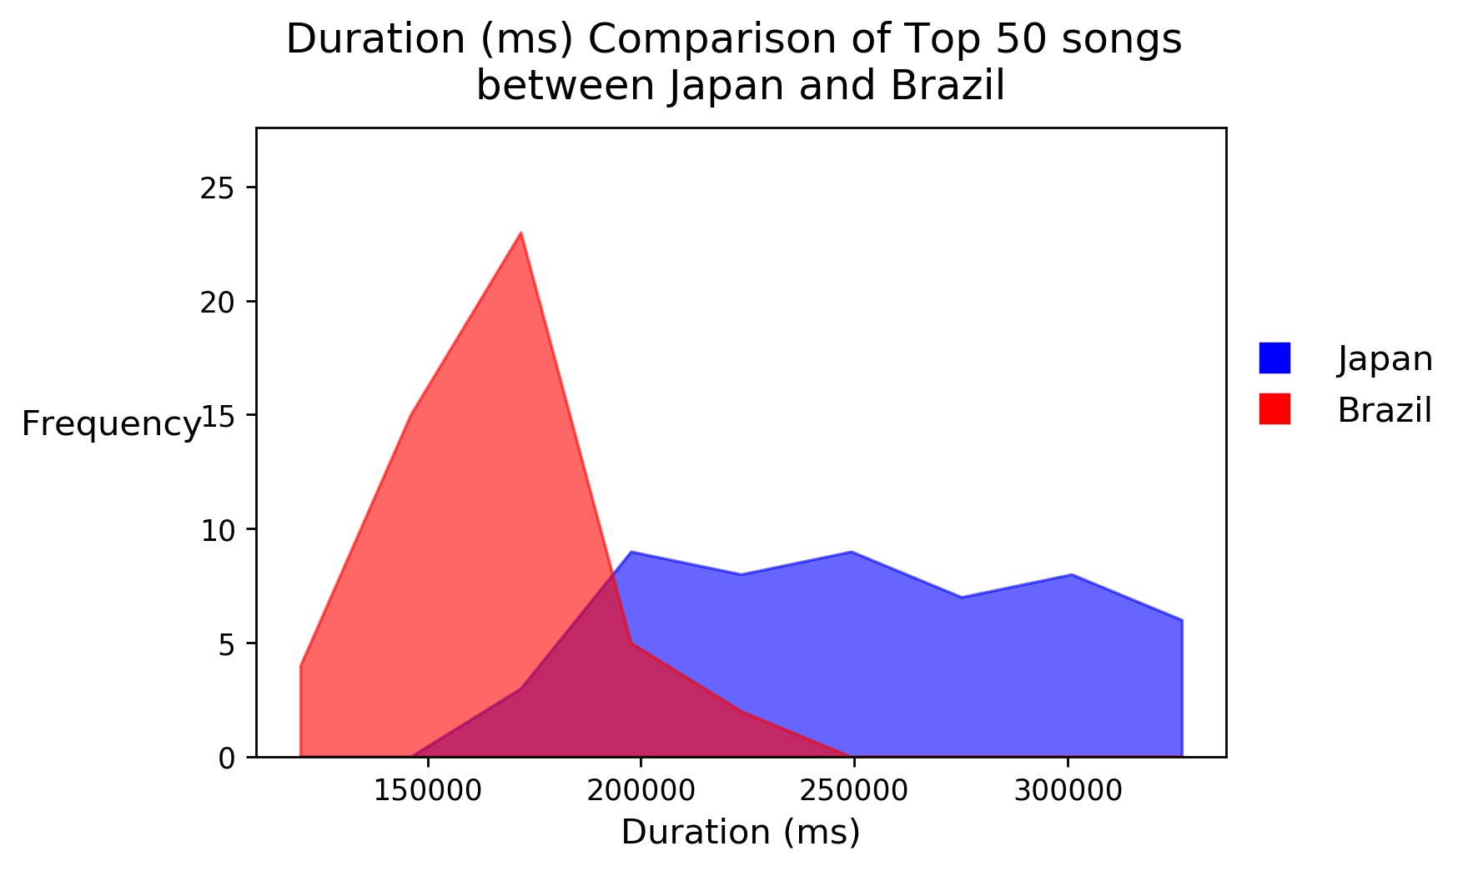
Duration
The duration of the track in milliseconds.

Slide 23
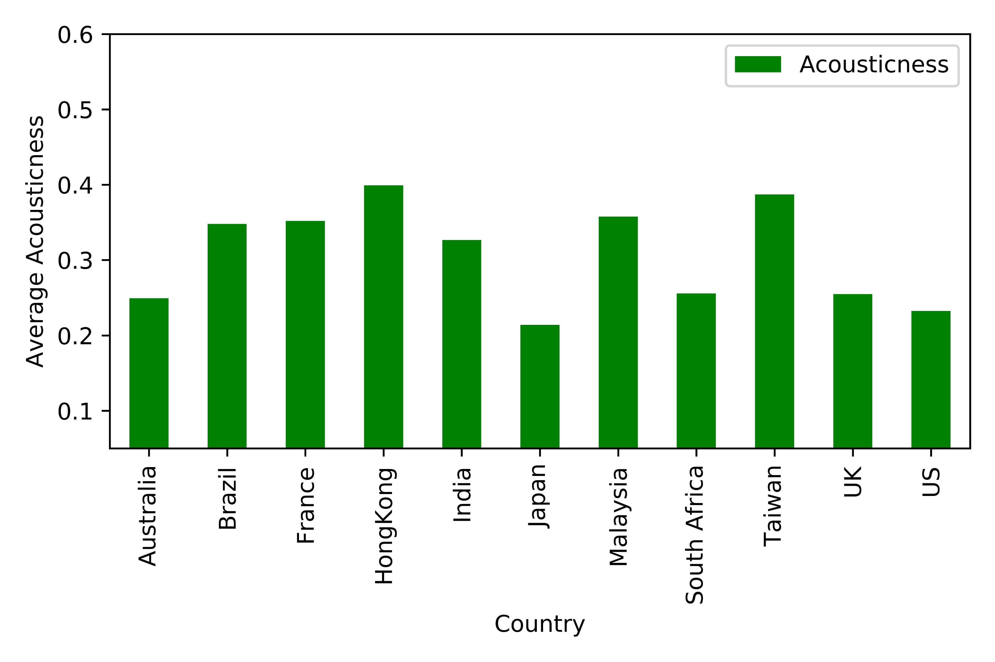
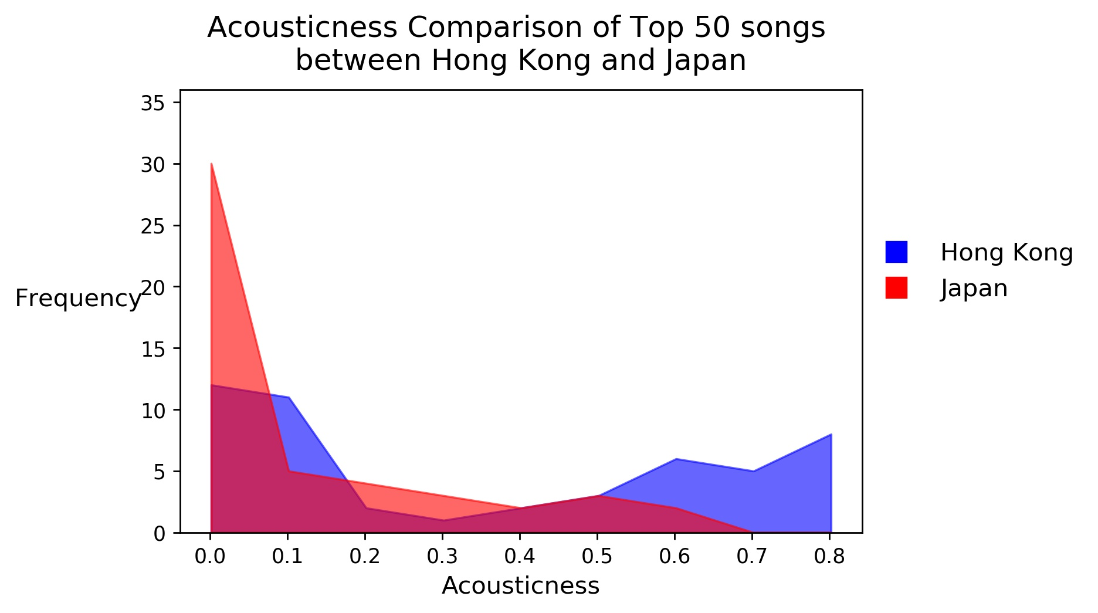
Acousticness
A confidence measure from 0.0 to 1.0 of whether the track is acoustic. 1.0 represents high confidence the track is acoustic.

Slide 24
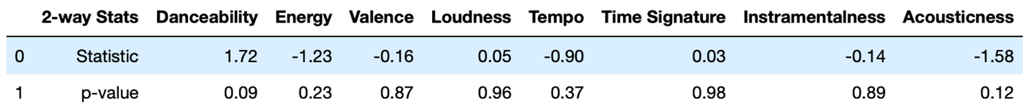
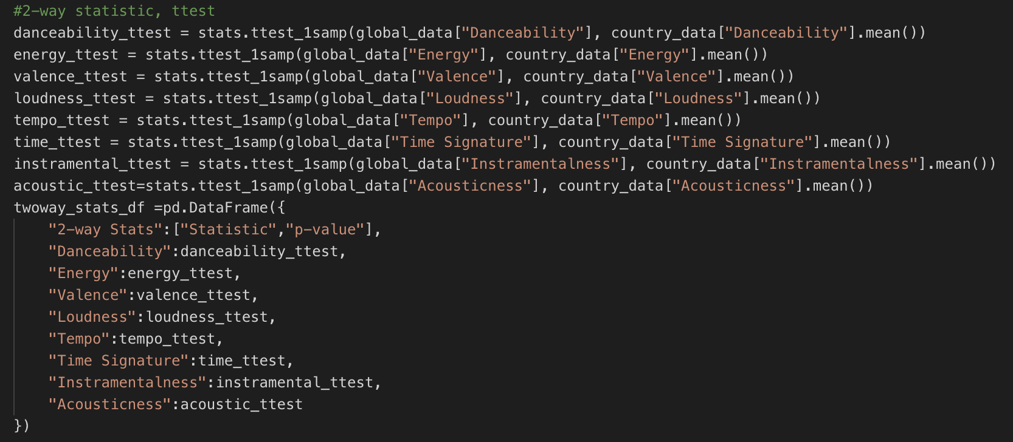
How good is our analysis?
Utilize two way T-test to analyze how close our selection of 11 countries’ charts compared to the global chart
Notes:
(two-sided test for the null hypothesis)
that the expected value (mean) of a sample of independent observations a is equal to the given population mean, popmean.

Slide 25
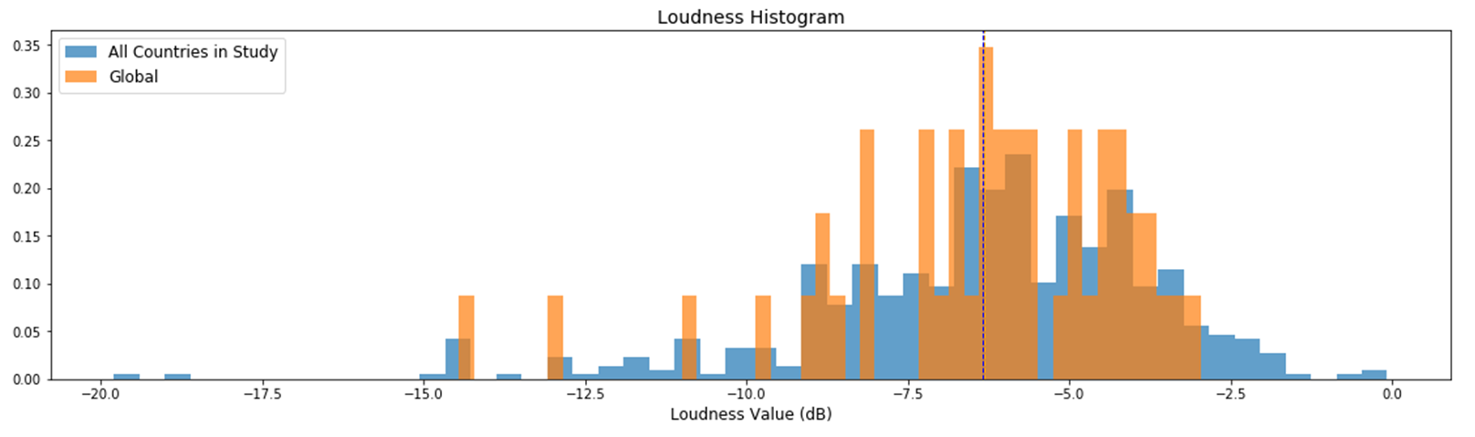
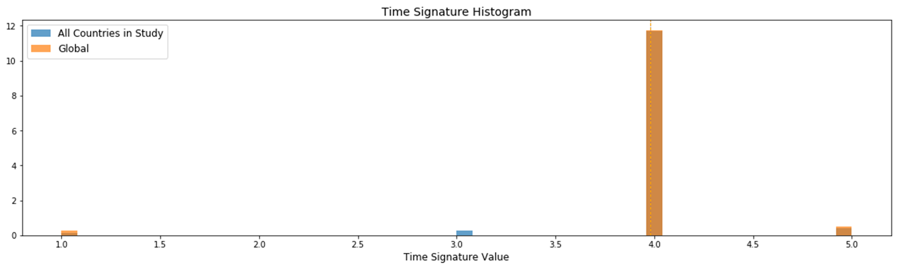
Loudness & Time Signature

Slide 26
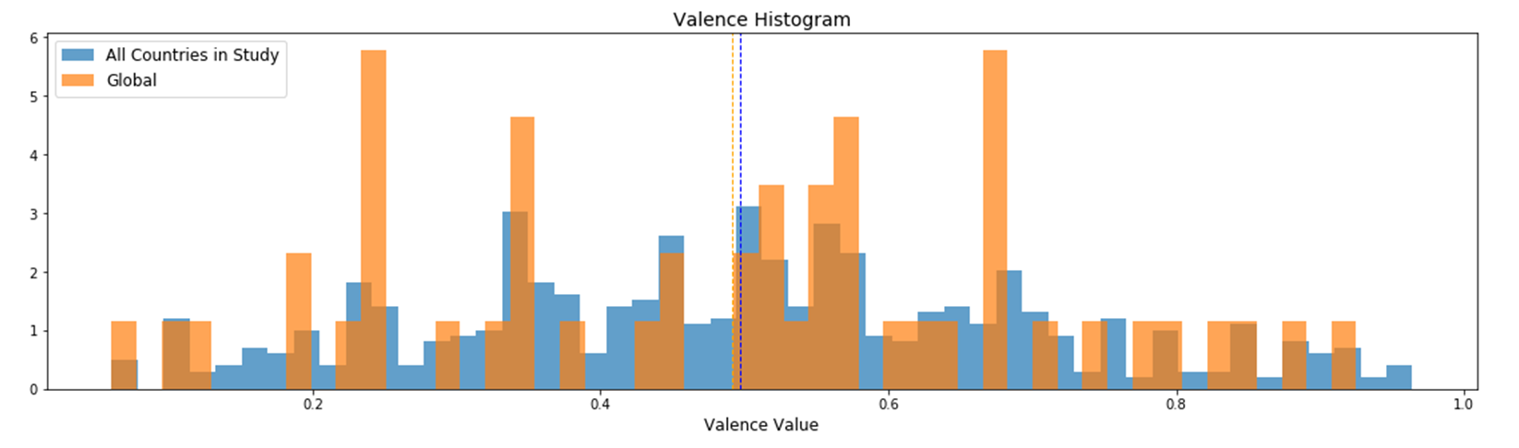
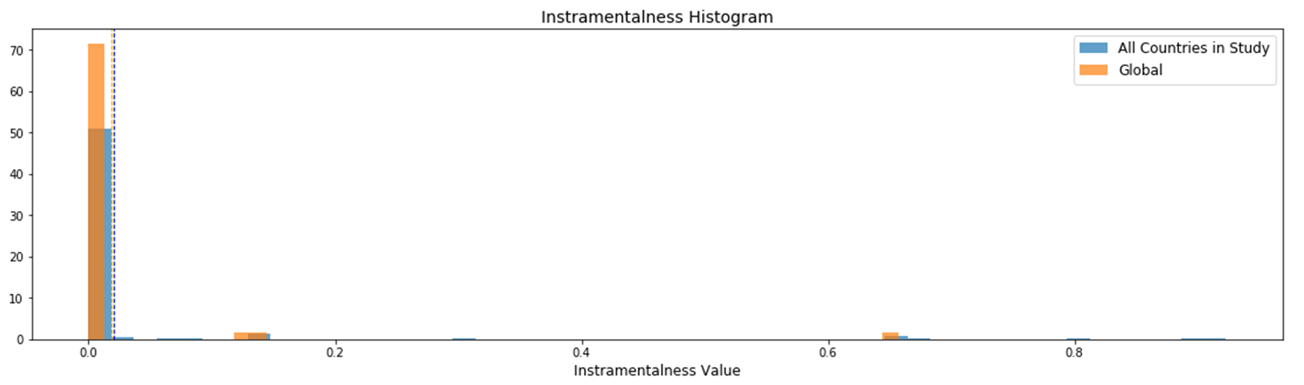
Valence & Instramentalness

Slide 27
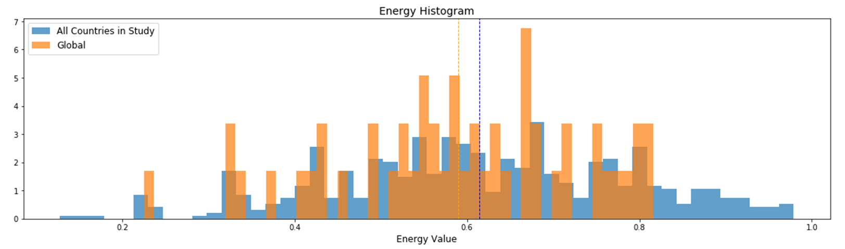
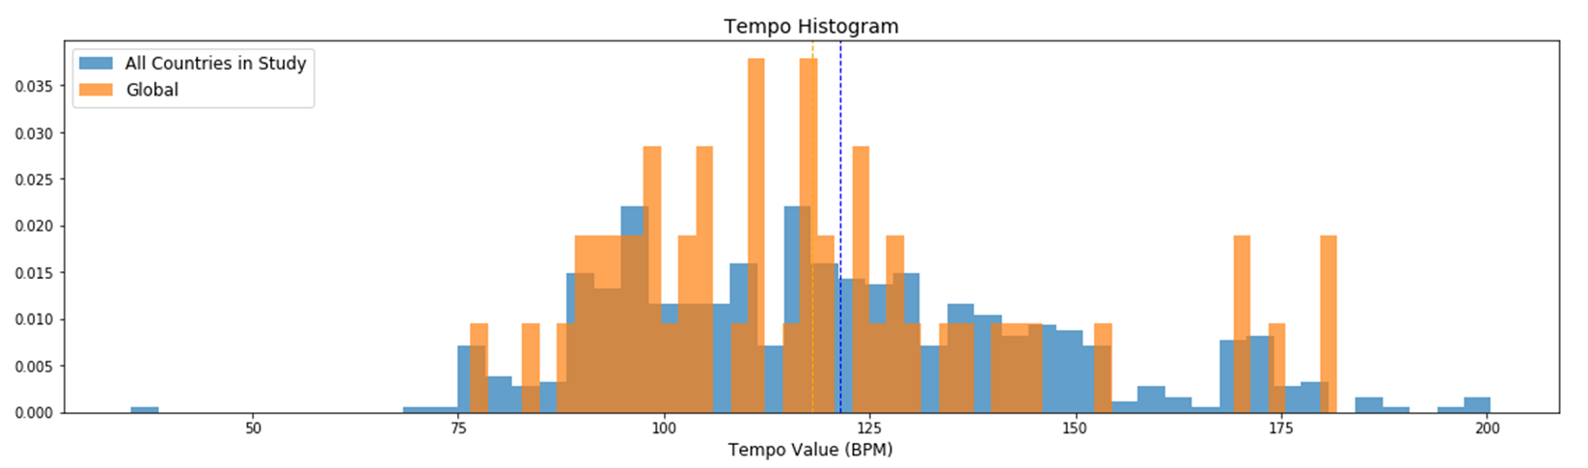
Energy & Tempo

Slide 28
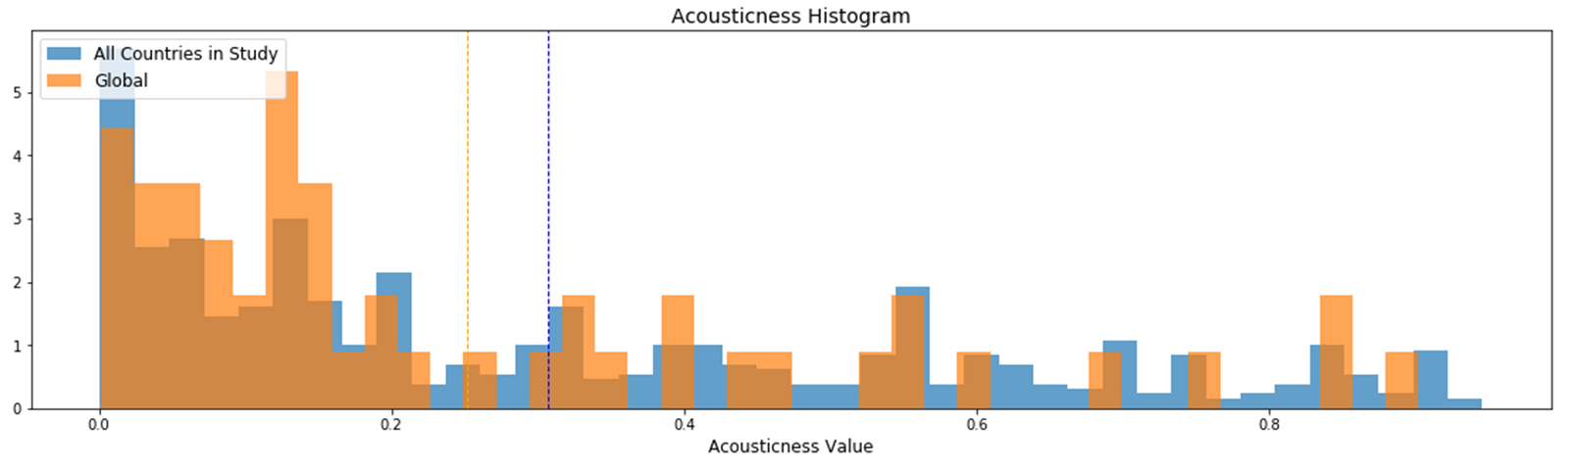
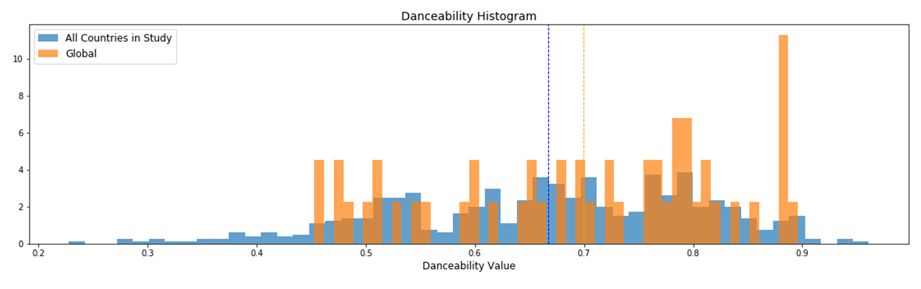
Acousticness and Danceability

Slide 29
ANALYSIS LIMITATIONS
Songs are only from a top 50 playlists
Each song in top 50 is weighed equally
Possible to miss the impact of a single viral song
Spotify only vaguely explains how some audio features are calculated
No access to confidence values
Notes:
Amos

